Slide 1
Management Information Systems
Executive Information System
and
Manufacturing Information System

Slide 2
Lecture Plan
Executive Information System
  Important Definitions
  Features of EIS
    Graphical
    Easy to use interface
    Broad and aggregated perspective
    Able to expand details
    Integrates many sources of data
Manufacturing Information System

Slide 3
Executive ?

Slide 4
Executive Information System
Executives
  An executive can be defined as “a manager at or near the top of the organizational hierarchy who exerts a strong influence on the organization” is known as an executive
Executive decision making
  Most executive decision fall into following three classes
    Strategic Planning
    Tactical Planning
    Fire-Fighting

Slide 5
Executive Information System
Strategic Planning
  Strategic planning involves determining the general, long term direction of the organization
Tactical Planning
  The tactical planning addresses the general concerns of the organization, it refers to the “HOW”, “WHEN”, “WHERE” issues involved in carrying out the strategic plan of the organization
Fire-Fighting
  Handling the major problems that arise in the organization from time to time is known as the fighting, announcement of an important product by a competitor is fire-fighting issue

Slide 6
Executive Information System
What is EIS
  Executive Information System provides the information to the very senior executives by summarizing and presenting data at the highest levels of aggregation.
  EIS involves presenting reports in standard formats as well as Graphic formats

Slide 7
Executive Information System
Characteristics of EIS
  Graphical
  Easy to use interface
  Broad and aggregated perspective
  Able to expand details
  Integrates many sources of data

Slide 8
Executive Information System
Graphics
  In EIS, graphics are used to different types of charts, e.g.,
    Pie Chart
    Bar Chart
    Gantt Chart etc.
  The purpose of GUI based interface and other graphics in EIS is to require as little knowledge and skills on the part of executive as possible

Slide 9
Executive Information System
Easy to use Interface
  Most of computerized Executive Information Systems are GUI (Graphical User Interface) based. They need a pointing devices e.g., a mouse, or a light pen.
  Some GUI based systems also use the touch screens.
  The GUI screen displays different ICONS or BUTTONS which represent the available information

Slide 10
Executive Information System
Broad and aggregated perspective
  The reports generated for the senior executives are highly summarized, these reports help these executives to take the decisions

Slide 11
Executive Information System
Able to expand details
  The executives should be able to expand the any summarized details when ever needed.
  In order to achieve this, the detailed reports are linked to the summarized reports

Slide 12
Executive Information System
Kinds of reports generated by the EIS
  Periodic
    Provide managers with information on a daily basis
  Demand
    Reports available on demand; no waiting
  Push
    Reports sent over intranets (to the executives and other employees through email systems)

Slide 13
Executive Information System
Integration of many sources of data
  The EIS accepts data from all of the other types of information systems
  It also accepts input from personnel who use the executive information system

Slide 14
Executive Information System
Commercially available EIS products
  Commander EIS (a product of Comshare, Inc.)
  Command Center (a product of Pilot Executive Software)
  Executive Edge
  Express EIS (a product of Information Resources, Inc)
  etc

Slide 15
Executive Information System
Integration of many sources of data
Other
Data
DSS
Data
TPS
Data
EIS Program
EIS Work Station
Graphics
Reports

Slide 16
Manufacturing Information System
What is Manufacturing Information System
  Manufacturing Information System provides the data necessary to plan, organize, monitor and control the manufacturing process

Slide 17
Manufacturing and Production Systems
Major functions of systems:
Scheduling, purchasing, shipping, receiving, engineering, operations
Major application systems:
Materials resource planning systems,
Purchase order control systems
Engineering systems
Quality control systems

Slide 18
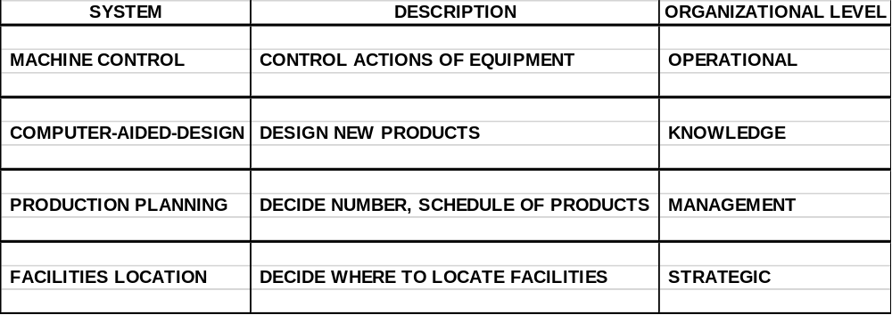
Manufacturing and Production Systems
Table 2-3

Slide 19
Manufacturing Information System
Hardware requirements
  Manufacturing Information System is different from the other information systems because it needs a variety of input and output devices
  These devices include sensors, e.g., the light sensors fixed to focus the products that pass through the belt.

Slide 20
Manufacturing Information System
CAD / CAM
  CAD stands for Computer Aided Designing where as CAM stands for Computer Aided Manufacturing
  With the help of CAD a computer designer designs a particular product on the computer with the help of a particular computer program

Slide 21
Manufacturing Information System
CAD / CAM
  The machines are attached to computer and the computer instructs the machines to generate the designed product
  The product can be part of computer e.g., a micro-processor whose circuit is designed on the computer and then transferred to the machine to give it a physical form

Slide 22
Manufacturing Information System
CAD / CAM
  CAD / CAM technology is being widely used now a days, especially for the production of electronics products where a high accuracy is needed to attach different components (very small in size) of an electronic circuit

Slide 23
Manufacturing Information System
Automated Material Handling software
  Automated Material Handling software tracks, controls and supports the movement of raw materials, material-in-process and finished goods from the receiving to the shipping.
  This software combines with various materials handling equipment, including conveyors, pick-and-place robots and automated guided vehicles, to get this job done

Slide 24
Manufacturing Information System
Material Selection Software
  The material selection software are integrated to the material testing machines via computers, different materials are tested with the help of machines and the test values are transferred to the computer
  The computer processes these values and identifies the best material depending on the criterion defined by the engineer

Slide 25
Manufacturing Information System
Materials Requirements Planning Software
  Materials requirements planning software uses data from the
    Master production schedule
    Item files
    Work center files
    Inventory files
    Bills of materials
  to estimate the future requirements of the materials, these calculations take a lot of time if performed manually and they may disturb the manufacturing process

Slide 26
Manufacturing Information System
Computer Simulation and Modeling
  A model is a simplified representation of real system
  Simulation is compression of time and space of a system to conduct what if experiments on a model of a system
  The simulation and modeling techniques help the manufacturing process by providing the training to the workers, and this training costs the least to the organization and it also removes the risk of damage

